Slide 1
Caption

Slide 2
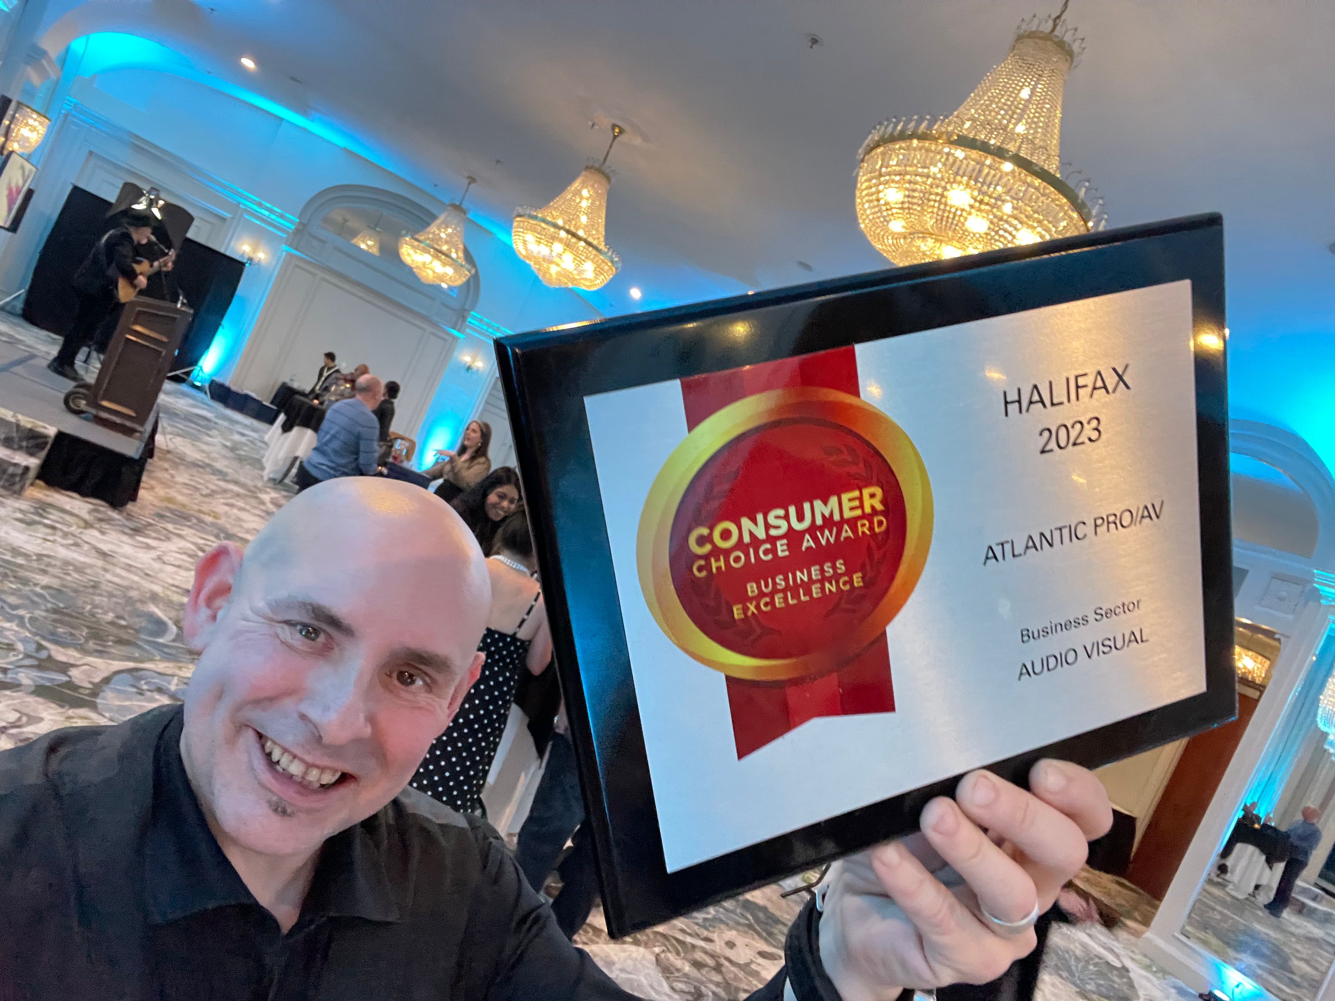
14 times winner of consumer Choice awards

Slide 3
About DJs and what we do!
How We do what we do!
Tips and Tricks to have a rocking reception
Here is what we will cover

Slide 4
What do DJs actually Do
We create the sound track of your wedding day!

Slide 5
What do DJs actually Do?
With the use of sound and lighting we give your wedding the look and feel you have envisioned!

Slide 6
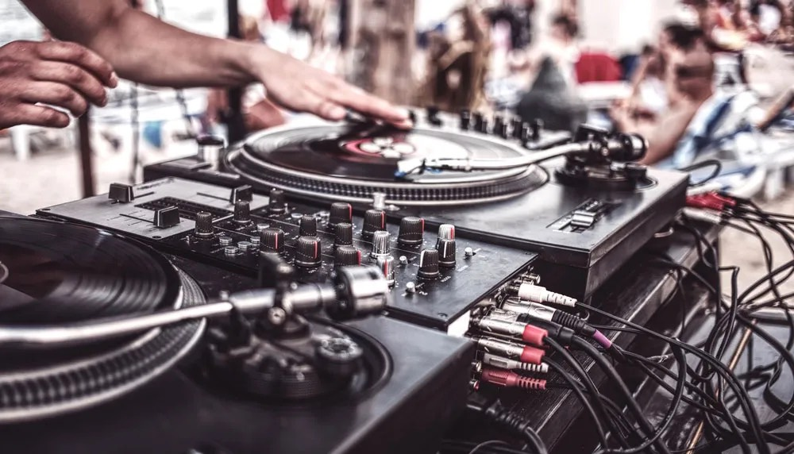
How do we mix music
By slowing down or speeding up songs and aligning the beats . We can mix songs together, which keeps people on the dance floor in a seamless flow of music!
We can also do transitions so that different genre or beats per minute can be interjected.
We can start song any where we wish and end it where we want to mix out. So we don’t need to play the entire track that’s 4 minutes long.

Slide 7
How do we know what to play
Input from the Bride & Groom via our Online Music Search Database. This lets them request the tracks they believe will go over well at their wedding.
In the planning form we provide, we ask questions that help us understand the music you enjoy. For example.
What year were you in grade 7?
Grooms parrents would real enjoy this song?
Growing up, me and my friend would love to dance to this song or genre of music?
We take request from your guest.
And we read the crowd!
Phone consult with DJ the week of the wedding.

Slide 8
We are people watchers (Reading the Crowd)
We are watching to note who is tapping their feet to the dinner & cocktail music!
We are seeing who is starting to dance in their chairs?
Who is on the dance floor? Who is not on the dance floor? What could we play to get them up?
Are the people dancing starting to look tired and it’s time to switch up the genre to get a different group up?
These are just a few of the clues we use!

Slide 9
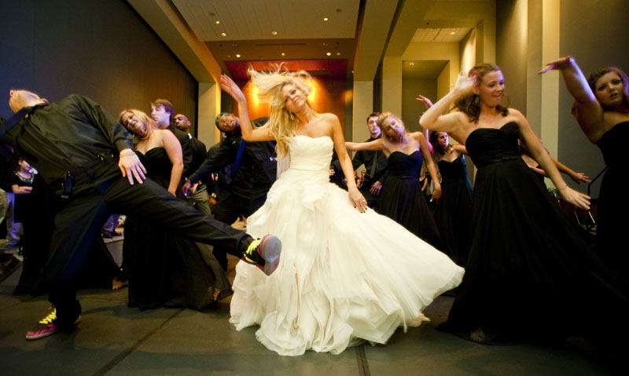
Tips &. Tricks To have a Rocking Reception

Slide 10
3 Things we will talk about!

Slide 11
Layout
Timeing
Food & Bar Options

Slide 12
Ceremony - 45 minutes
Pictures - 1.5 Hrs
Cocktail - 1 hr
Dinner 1.5 hrs
Speeches 45 Min
Dance party - 3 to 4 Hrs

Slide 13
Room Layout rules For reception
Keep everyone and everything in one room. Do not divide the crowd.
We all want to do what other people are doing. So dividing activities such a photo booth outside the room kills the vibe.
Having the bar outside of ballroom kills the party! All the party people are not even in the same room as the dance floor. If you have to have it in a different room make sure doors are left open so people can still hear the music while they are out there.
Example: House parties always revolve around the kitchen because thats where the alcohol is!

Slide 14
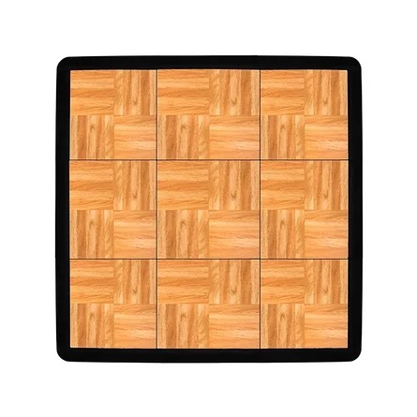
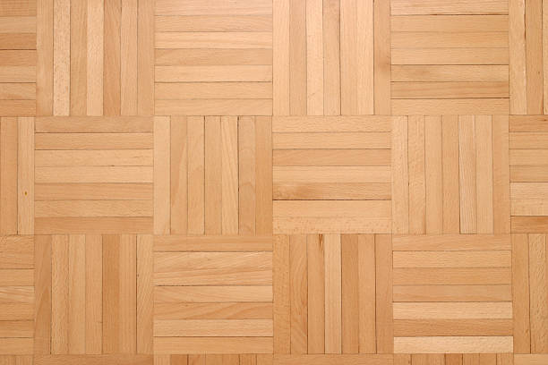
Bar
The Best Layout
D J
Head Table
Photo Booth
during cocktail
or dinner
Watching people on the dace floor will make your
guest want to be dancing also!

Slide 15
Bar out side of the room
Leaving 20% of the people
Not in your ballroom!
Not so good Layout
D. J
Head Table
Guest are disconnected from the activities on the dace floor.
Resulting In less dancing

Slide 16
Photo Booth
1). Ideally located as same room as dinner or cocktail HR
2) Only have it open during cocktails or dinner.

Slide 17
Timing is Everything !
Get Behind
You’ll be listening to speeches at 10:30
Get Ahead
Your be asking the DJ to
start the dance at 7:30

Slide 18
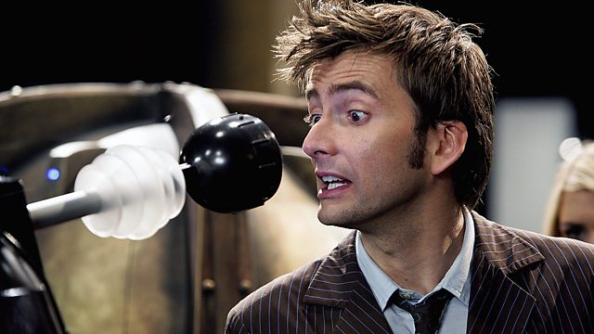
Did you know,
your MC can
control time?
Just Like Doctor Who!

Slide 19
Arm your MC with Information
& Tools

Slide 20
Arm your MC with Information
& Tools
Give him all the details with a planned timeline.

Slide 21
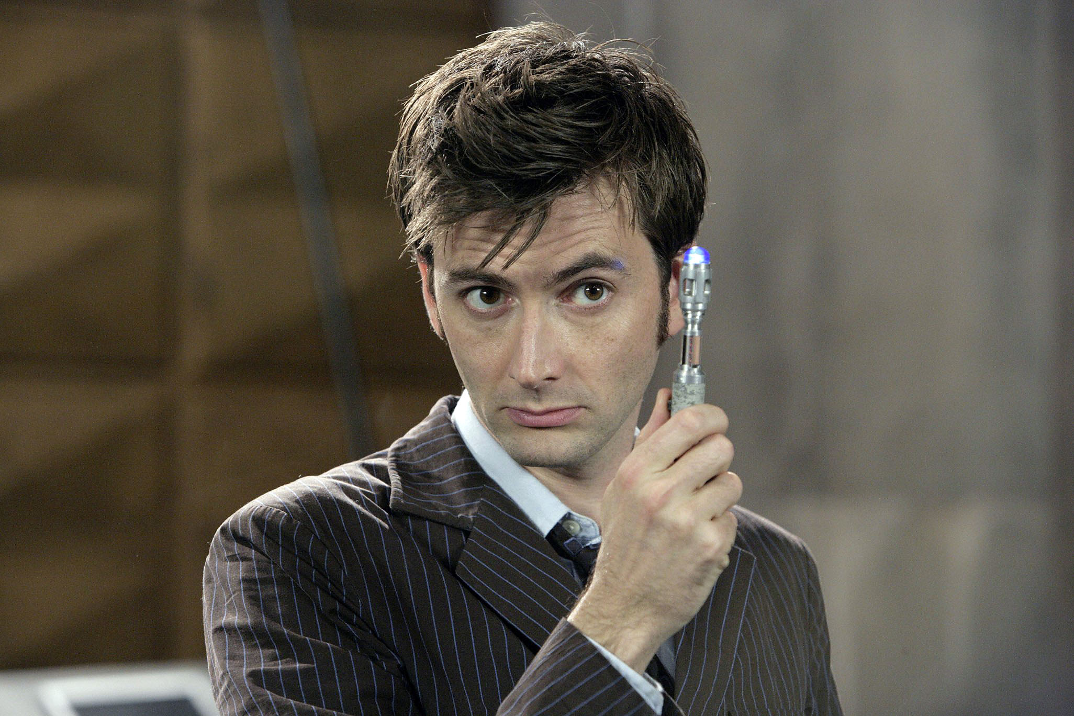
Your Goal:
MC to host and control time so
you stay on schedule!

Slide 22
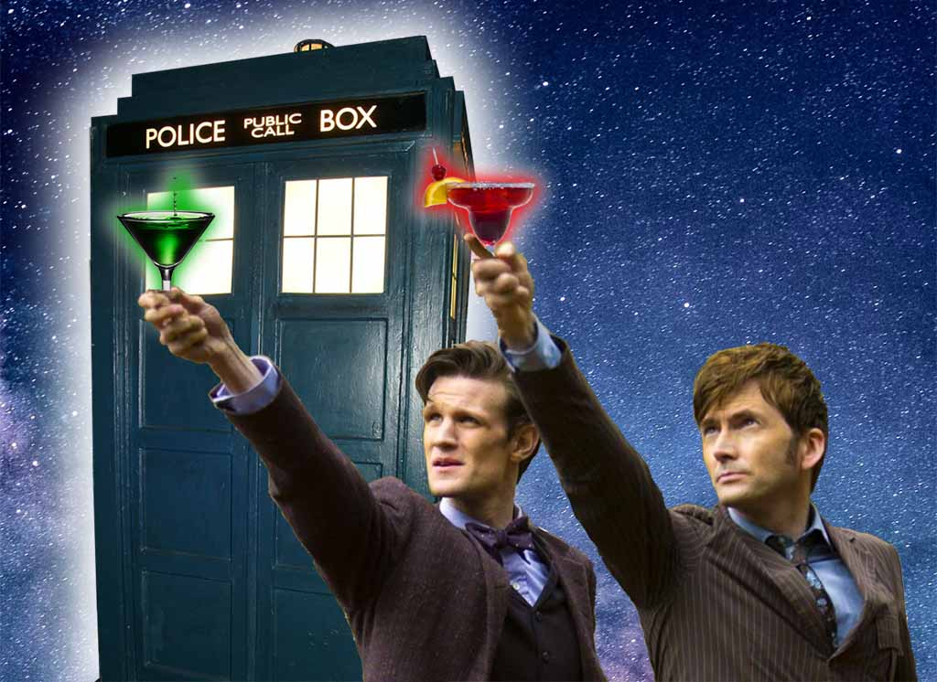
MC’s Goal:
Get everything
crossed of the list
so that he/she can have a drink!

Slide 23
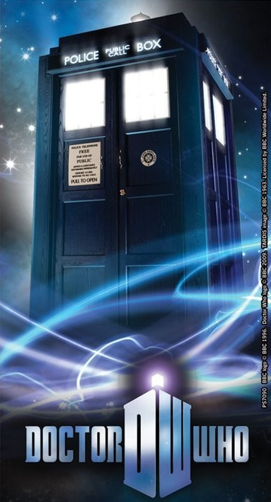
Reception Schedule
}
Doors Open 6:15
Dinner starts 6:30, (Recommended)
Shoe Game
Photo Booth
Cut the Cake
Best Man Speech
Maid Of Honour Speech
Parrents 0f the Bride Speech
Parrents Of the Groom Speech
Bride and Broom Speech
First Dance 9, 9:30 is the latest (recommended)
Late Night Snack 10:30 at the earliest.
Last Call 12:30
Last Dance 1AM
Flexible & Controlable
Time Machine Friendly

Slide 24
Reception mod for Stretching Time
Appetizer 6:30
Main Coarse
Dessert
Shoe Game
10 minutes between
Cut the Cake
10 minutes between
Best Man Speech
10 minutes between
Maid of Honour Speech
10 minutes between
Parrents of the Bride Speech
10 minutes between
Parrents Of the Groom Speech
10 minutes between
Bride and Broom Speech
10 Minutes between
First dance 9:30
*Gives time for people to talk and get a beverage

Slide 25
Reception mod for
getting back
on Schedule
Appetizer 6:30
Shoe Game
Main Coarse
Cut the Cake
Dessert
Best Man Speech
Maid of Honour Speech
Parrents of the Bride Speech
Parrents Of the Groom Speech
Bride and Broom Speech
First dance 9:30
*Gives time for people to talk and get a beverage

Slide 26
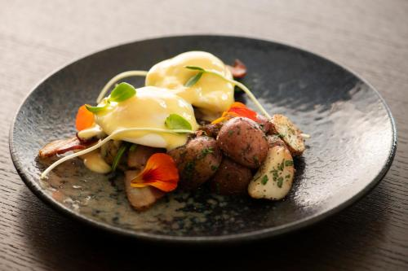
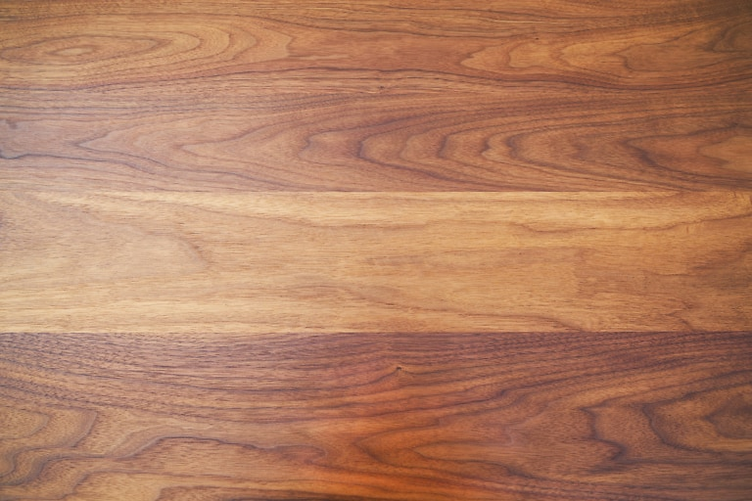
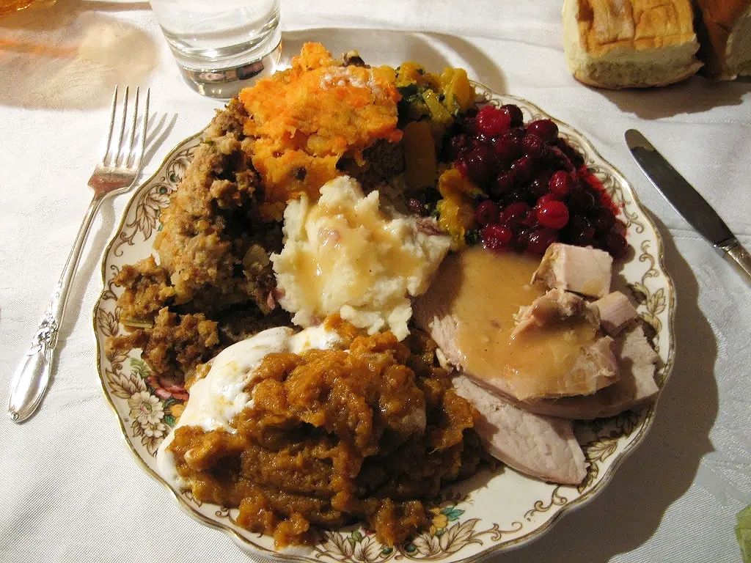
Served Dinner
Or Buffet?

Slide 27
Disadvantage of Buffet
People over eat.
Quick eating time.
No opportunity to Control time
No time to socialize and talk
Advantage of served meal
Controlled Portions
Time to digest Meal
Socialize between courses
Time to enjoy the table wine or a beverage
Time control options

Slide 28
Problem:
Groups of people leave the ballroom to go
back to their room for a few Cheap drinks
Solution:
Open Bar for at
least the First Hour

Slide 29
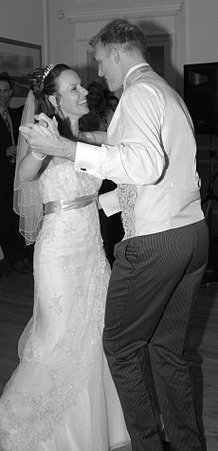
First dance Songs
Long enough for the photographer to get their shots. 2:30
A song that is in some way special to you, Lyrics, or a memory, whatever!
It can be any song - Its your wedding! Dancing does not have to be Choreograph!
It can be just the two of you staring into each other eyes and enjoying the moment! Beautiful! But practice so your comfortable!

Slide 30
Parrents Dance
Long enough for photographer to get shots 2:30
Its does not need to be slow and sappy
It can be what ever you want!

Slide 31
Westin Special
DJ Celebration Package Reg $875.00. Just $775.00
6 Hrs of DJ Services
2 12 Inch Sub Speakers
2 7 feet tall Top end Speakers
Top Teir DJ
DJ Console with laptop & Back up Laptop
Back up Mixer
Phone Consult with your DJ week of the wedding
Client Log in area, and online request system

